Slide 1
CAN MATHEMATICS BE APPEALING TO THOSE WHO WANT TO TEACH PK-6?
SERGEI ABRAMOVICH
DEPARTMENT OF ELEMENTARY EDUCATION

Slide 2
Abstract. The presenter intends answering this question in affirmative by reflecting on his participation in two meetings with high school seniors organized by the Admissions Department of SUNY Potsdam this past spring under the umbrella "Accepted Student Days." The goal of the meetings (as well as of this presentation) was (is) to show a friendly face of mathematics using counting, action learning, and common sense.

Slide 3
Action Learning: The concept of action learning is understood as learning through students’ work on a real problem followed by true reflection on this work and seeing learning as the primary goal of the action.
Revans, R. W. Action Learning: New Techniques for Management; Blond & Briggs: London, England, 1980.

Slide 4
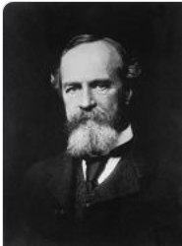
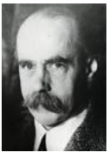
“Any object not interesting in itself may become interesting through becoming associated with an object in which an interest already exists” [W. James, Talks to Teachers on Psychology, Harvard University Press, Cambridge, MA, 1983, p. 62].
When given a problem which grew out of a concrete situation with which a so-called ‘low-level’ student was familiar and the solution of which “was required by the situation, she encountered no unusual difficulty, frequently showing excellent sense” [M. Wertheimer, Productive Thinking, Harper & Brothers, New York, NY, 1959, pp. 273-274].
1842-1910
1880-1943

Slide 5
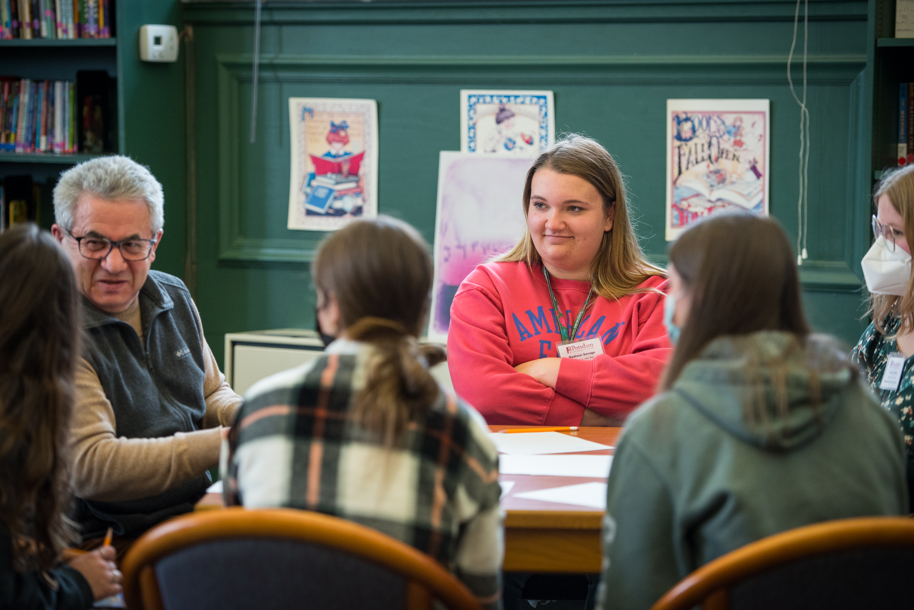

Slide 6
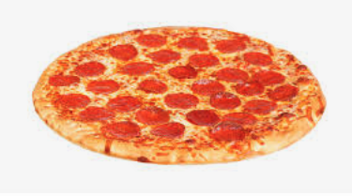
How to divide 3 pizzas among 5 people fairly with fewer than 15 pieces?

Slide 7
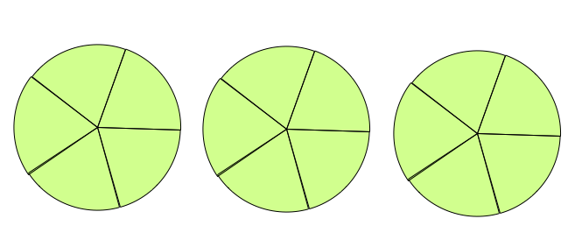
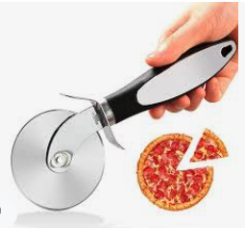
A
B
E
A
B
C
C
D
E
D
15 pieces

Slide 8
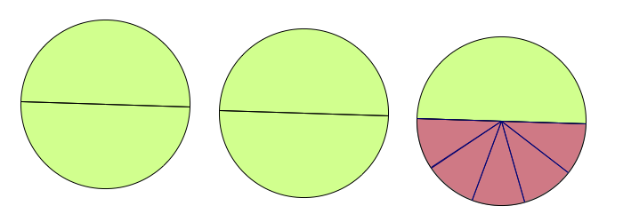
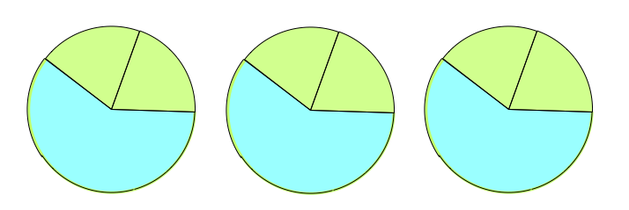
A
B
A
C
E
E
C
B
A
E
D
D
B
C
D
15 pieces
10 pieces
D
D
E
D
E
E
A
B
C
A
B
C
9 pieces
D
E

Slide 9
How to divide 5 pizzas among 6 people fairly with fewer than 30 pieces?

Slide 10
A
B
C
D
E
F
A
F
B
30 pieces
E
C
D

Slide 11
A
B
C
D
E
F
A
F
B
30 pieces
E
C
D
A
C
E
B
E
A
D
12 pieces
B
D
F
C
F
F
F
F
F
F
10 pieces
A
B
C
D
E

Slide 12
How to divide 4 pizzas among 7 people fairly with fewer than 28 pieces?

Slide 13
A
B
C
D
E
F
G
A
B
C
G
F
D
28 pieces
E

Slide 14
A
B
C
D
E
F
G
A
B
C
G
F
D
28 pieces
E
A
C
E
G
14 pieces
A
G
B
D
F
B
F
C
D
E
E
E
E
F
F
F
G
G
E
F
G
G
16 pieces
A
B
C
D

Slide 15
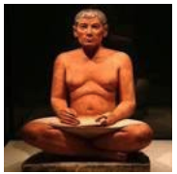
GOING BEYOND COUNTING. PLEASE DON’T LEAVE!
A
B
A 1/2
C
E
E
D
C
A
B
D
E
B
D
C
1/2 + 1/10 = 3/5
Egyptian fraction
A 1/10
D
D
E
E
D
E
(D+D)+(D+E)+(E+E)=(D+D+D)+(E+E+E)
2 + 2 + 2 = 3 + 3
3x2=2x3
Ahmes, 1550 BC
The first mathematician
A
B
C

Slide 16
GOING BEYOND COUNTING. PLEASE DON’T LEAVE!
A
F
B
E
C
D
A 1/2
C
E
A
1/3
B
E
1/2+1/3=5/6
Egyptian fraction
D
B
D
F
C
F
(A + F) + (A + F) + (A + F) + (A + F) + (A + F) =
(A + B + C + D + E)
+ (F + F + F + F + F)
2 + 2 + 2 + 2 + 2 = 5 + 5
5x2 = 2x5
F
F
F
F
F
A
B
C
D
E

Slide 17
GOING BEYOND COUNTING. PLEASE DON’T LEAVE!
A
B
C
G
F
D
E
1/2 + 1/14 = 4/7
Egyptian fraction
A 1/2
C
E
G
A
G
B
D
F
B
F
A 1/14
C
D
E
(A + E + E + E) + (B + E + F + F) + (C + F + F + G) + (D + G + G + G) = (E + E) + (E + E) + (F + F) + (F + F) + (G + G) +
(G + G) + (A + B) + (C + D)
4 + 4 + 4 + 4 =
2 + 2 + 2 + 2 + 4 + 2 + 2 + 2
4x4 = 8x2
E
E
E
F
F
F
G
G
E
F
G
G
A
B
C
D

Slide 18
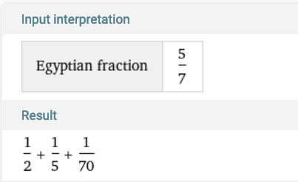
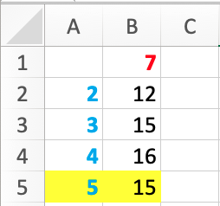
GOING BEYOND COUNTING. PLEASE DON’T LEAVE!
Stephen Wolfram
35 vs 21 vs 15
1/2 + 1/5 + 1/70 = 5/7
Egyptian fraction

Slide 19
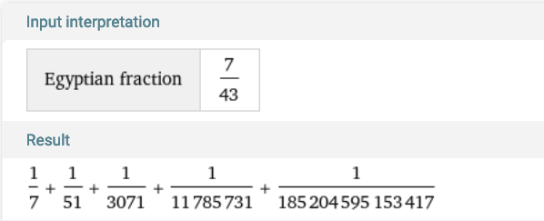
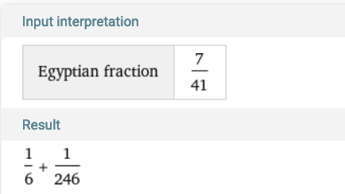
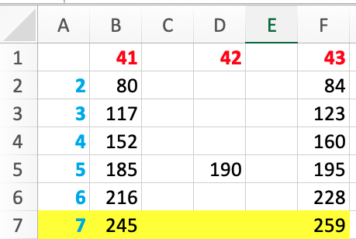
GOING BEYOND COUNTING. PLEASE DON’T LEAVE!
7x43 = 301 vs 5x43 = 215 vs 259
Stephen Wolfram
COMPARE AND CONTRAST
7x41 = 287 vs 2x41 = 82 vs 245

Slide 20
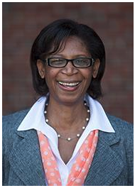
ALMOST DONE. PLEASE DON’T LEAVE!
Deb Conrad

Slide 21
THANK YOU!

